Slide 1
Safety Minute
OSHA Recordkeeping
All municipalities are to keep active OSHA 300 logs.
Requirements of how to do this in CFR 1904.
Note: workers comp cases are not always recordable!!
Unlike private sector counterpart, you do NOT have to submit electronically unless requested to do so.
Hard Hat vs. Safety Helmets
OSHA has shifted in recommending/ requiring safety helmets vs. traditional hard hats.
Required hazard assessments to determine safest option.
Recent Fatality Acknowledged
Jennifer Tetreault-Mannarino,MSP OSHM
Authorized OSHA Outreach Trainer
Owner/ Director HazCommpliance, LLC

Slide 2
Safety Minute
OSHA Recordkeeping
All municipalities are to keep active OSHA 300 logs.
Requirements of how to do this in CFR 1904.
Note: workers comp cases are not always recordable!!
Unlike private sector counterpart, you do NOT have to submit electronically unless requested to do so.

Slide 3
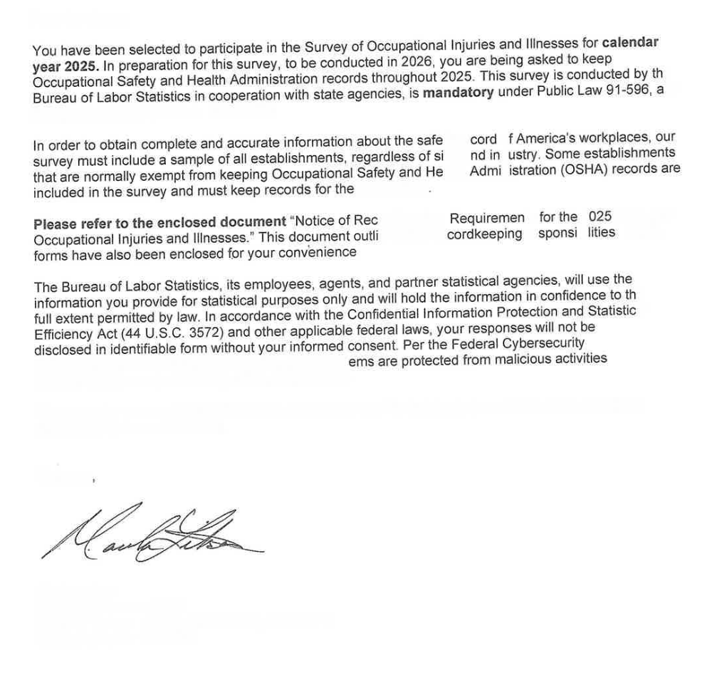

Slide 4
7.0 OSHA 300 Online Submissions
• Public sector employers do not submit their OSHA 300 Log to the OSHA online tracking application.
www.osha.gov/injuryreporting. This is only required for private sector employers.
• Employers must continue submitting the Form 101 – Employer’s First Report of Injury/Fatality to DIA. The DIA
worker’s compensation reporting is separate from the DLS OSHA 300 Log. https://www.mass.gov/how-to/filean-
employers-first-report-of-injury-illness-or-death-form-101-online.
• Employers selected for the BLS survey will be sent log-in information in January after the collection year to
submit their information.

Slide 5
Safety Minute
Hard Hat vs. Safety Helmets
OSHA has shifted in recommending/ requiring safety helmets vs. traditional hard hats.
Required hazard assessments to determine safest option.

Slide 6
1926.100(a)Employees working in areas where there is a possible danger of head injury from impact, or from falling or flying objects, or from electrical shock and burns, shall be protected by protective helmets.
Choosing the right head protection
Employers must conduct a hazard assessment at their job site and based on the workplace hazards determine whether head protect ion is necessary and if so, the most appropriate type.
Considerations when selecting head protection.
Construction Sites.
For construction sites, especially those with high risks of falling objects and debris, impacts from equipment, awkward working positions, and/or slip, trip, and fall hazards: consider Type II head protection with chin straps.
https://www.osha.gov/sites/default/files/publications/safety_helmet_shib.pdf

Slide 7
Safety Minute
Man Killed At Greenfield Job Site
A man was killed last week in western Massachusetts after falling into a silo used to mix concrete.
https://dailyvoice.com/ma/westfield/matthew-nedorostek-idd-as-man-killed-at-greenfield-job-site/

Slide 8
Who’s Controlling Traffic in the
WORK ZONE?

Slide 9
Police Detail:
Any uniformed sworn law enforcement officer and/or any officially marked police vehicle on a Public Works Project

Slide 10
Road Flagger:
An individual certified by MassDOT, or a MassDOT approved organization, to perform traffic control services on Public Roads.

Slide 11
Traffic Control Officer:

Slide 12


