Slide 1







PFAS Discussion Topic
Mass Highway Assoc

Slide 2




Who’s on our Panel?
Linda Cook
Senior Technical Leader
Weston & Sampson
cook.linda@wseinc.com
Laurie J. Ruszala, P.E.
Water & Wastewater Superintendent
Town of Yarmouth
lruszala@yarmouth.ma.us
Natalie Johnson, PhD
Mass DEP
Bureau of Waste Site Cleanup
Northeast Regional Office
natalie.johnson@mass.gov
Michael O’Connell
Deputy Director of Water
Town of West Springfield
moconnell@tows.org

Slide 3

Agenda
PFAS Intro
Exposure and Risk
Your Potential Exposures
Federal and Mass Regulations
Why Should I Care About PFAS
Yarmouth’s Story
1
2
3
4
5
6

Slide 4
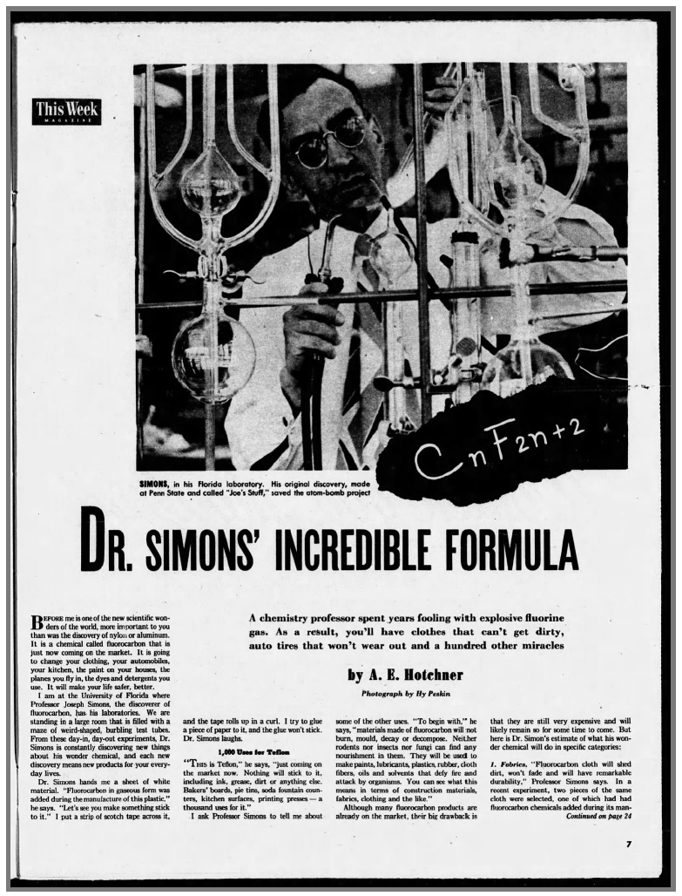
The Promise of Fluorocarbons
Manmade specialty chemicals
Accidentally discovers PTFE/ Teflon –1938
Fluoropolymers essential to WWII efforts, especially for handling uranium
Post-war patents and commercialization in early 1950s
Promise of making life “safer, better”
Used in fabric coatings, paints, fire extinguishers, and more
Materials recognized for stability and slickness
“You’ll have clothes that can’t get dirty, auto tires that won’t wear out and a hundred other miracles”
Los Angeles Times, June 14, 1953
Notes:
Like so many great scientific discoveries, PTFE (commonly known as Teflon) was discovered by accident while Dr. Plunkett while he was working with refrigerants. The material he discovered was inert to almost all chemicals and was very slippery. No other compounds or materials had these same unique attributes. At the time, these compounds were considered to be miraculous.

Slide 5
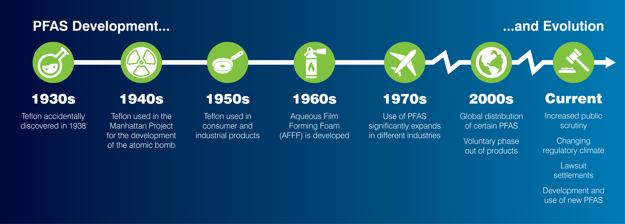
Decades of Use Across Industries
Infographic inspired by:
https://www.kimley-horn.com/news-insights/perspectives/what-is-pfas/
Notes:
Because of their unique properties, PFAS compounds have been used for decades in a wide variety of applications including fire fighting foam, textiles, food packaging, cosmetics, building materials and medical devices, to name just a few. For many of these uses, like healthcare and electronics, there are currently no replacements for PFAS. In these cases, PFAS are considered to be an “essential use”. What we are seeing are regulations targeting the nonessential uses of PFAS in consumer products and food packaging and fire fighting foam.

Slide 6
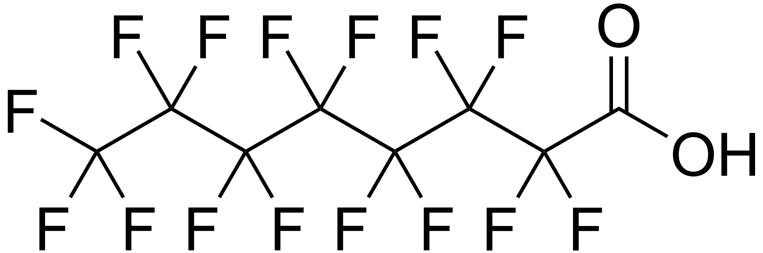
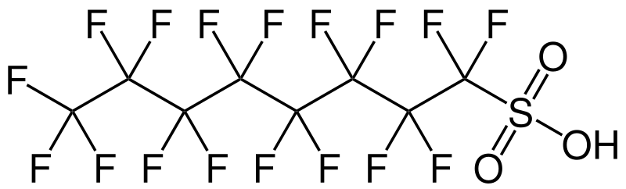
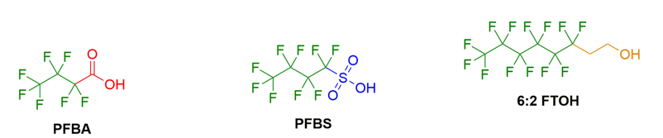
The Basics
PFAS = per- and poly- fluoroalkyl substances
Perfluorooctanoic acid (PFOA)
Perfluorooctanesulfonic acid (PFOS)
Fluorine atoms bonded to carbon charin
Thousands of these substances exist, with very different physical and chemical properties
  Differentiated by chain lengths and end groups

Slide 7


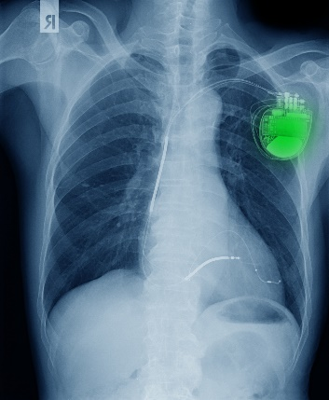














They’re in Everything

Slide 8
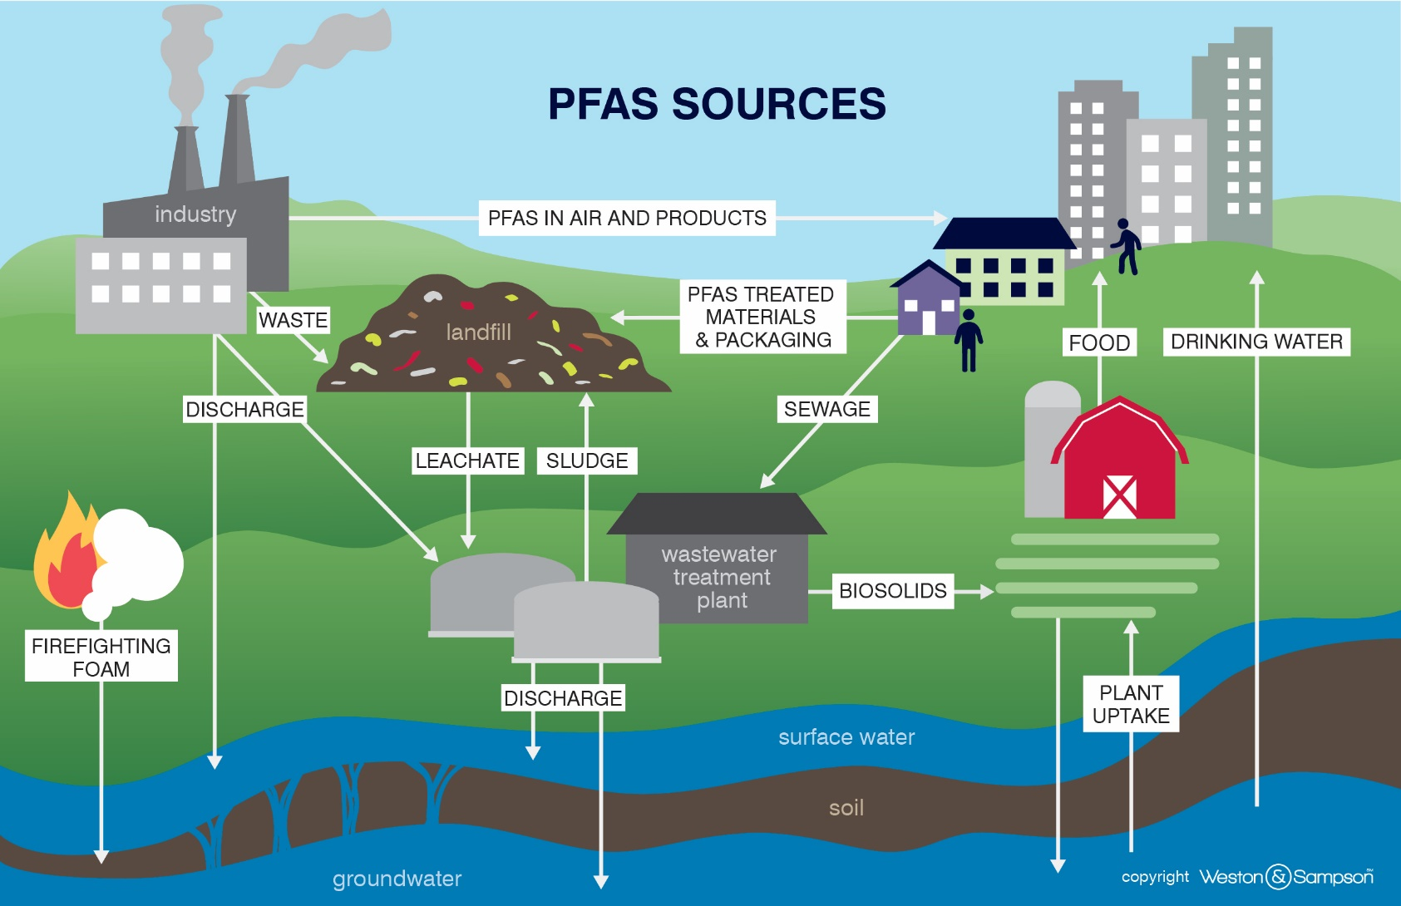
They’re Everywhere

Slide 9
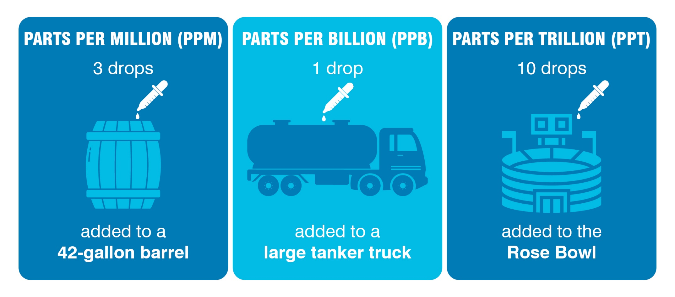
How much is that?

Slide 10
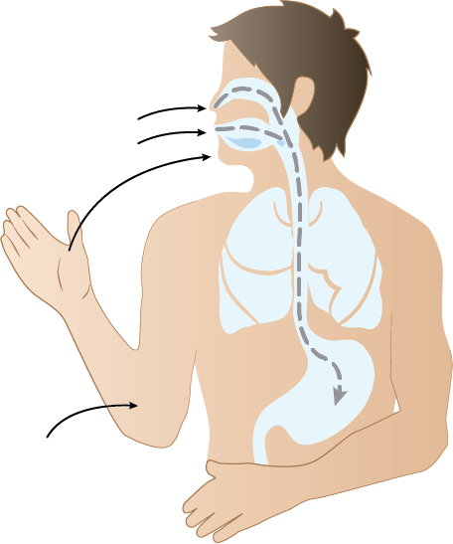
Exposure and Risk
Ubiquitous
Bioaccumulates
Health Impacts
  Liver (cholesterol)
  Immunological (vaccination response)
  Developmental effects (birth weight)
  Thyroid
  Cardiovascular (hypertension)
  Cancer (testicular, kidney)
Potential adverse effects at low concentrations
Primary exposure from drinking water
Inhalation
Ingestion
Indirect oral/
hand-to-mouth
Skin absorption
Notes:
So why has PFAS concern risen so dramatically in recent years?
Dispersed across the globe and is found virtually everywhere
PFAS bioaccumulate in human and animals. It is usually detected when tested for in human blood. So, we have all been exposed.
There are some direct health impacts that have been reported at higher PFAS concentrations, as listed here
But tox studies indicate low concentrations may also pose adverse effects, but more research is needed
We can be exposed via inhalation, via skin adsorption, and ingestion.
Ingestion of contaminated water is seen as a primary route of exposure.
EPA has recently finalized new drinking water regulations to aid with reducing this exposure.

Slide 11
Your Potential PFAS Exposures

Slide 12
Your Potential Exposures
Potential Exposures
Chemicals and cleaning products at work and home
Ingestion from touching PFAS containing materials
Cookware treated PFAS (e.g., Teflon)
Beach/stream foam
Drinking water
Minimizing Exposure
Review SDS for products you are using
Wear appropriate PPE when handling chemicals
Wash hands after chemical exposure and before eating
Test residential well water, use carbon filtration, if needed
Avoid PFAS treated products

Slide 13
Federal Regulations

Slide 14
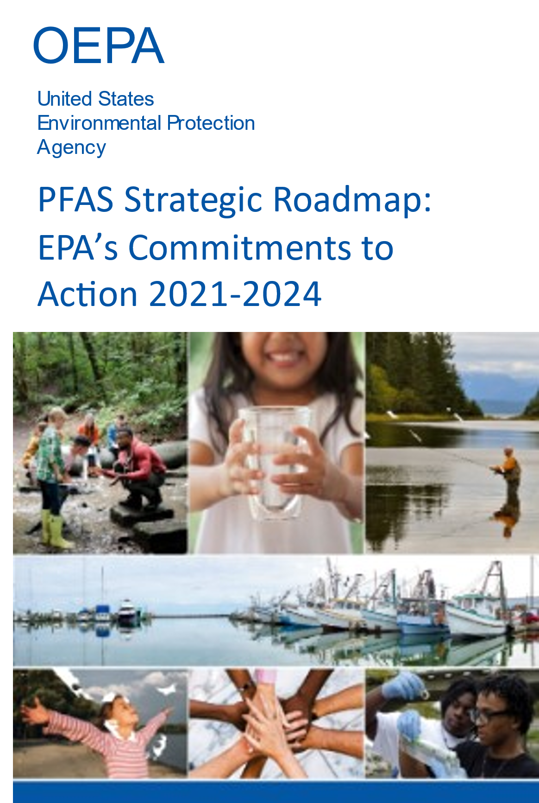
EPA Road Map
RESTRICT Pursuing a comprehensive approach to proactively prevent PFAS from entering air, land, and water at levels that can adversely impact human health and the environment.
REMEDIATE Broadening and accelerating the cleanup of PFAS contamination to protect human health and ecological systems.
RESEARCH Investing in research, development, and innovation to increase understanding of PFAS methods, human health and environmental risks, and technologies.
14
Notes:
31 proposed task items

Slide 15
National Primary Drinking Water Regulation
Compound | Final MCLG | Final MCL (enforceable levels)
PFOA | Zero | 4.0 ppt
PFOS | Zero | 4.0 ppt
PFHxS | 10 ppt | 10 ppt
PFNA | 10 ppt | 10 ppt
HFPO-DA (GenX Chemicals) | 10 ppt | 10 ppt
Mixtures containing two or more of PFHxS, PFNA, HFPO-DA, and PFBS | 1 (unitless) Hazard Index | 1 (unitless) Hazard Index
Initial monitoring by 2027
Inform public beginning in 2027
5 years to implement PFAS reduction solutions by 2029
15

Slide 16
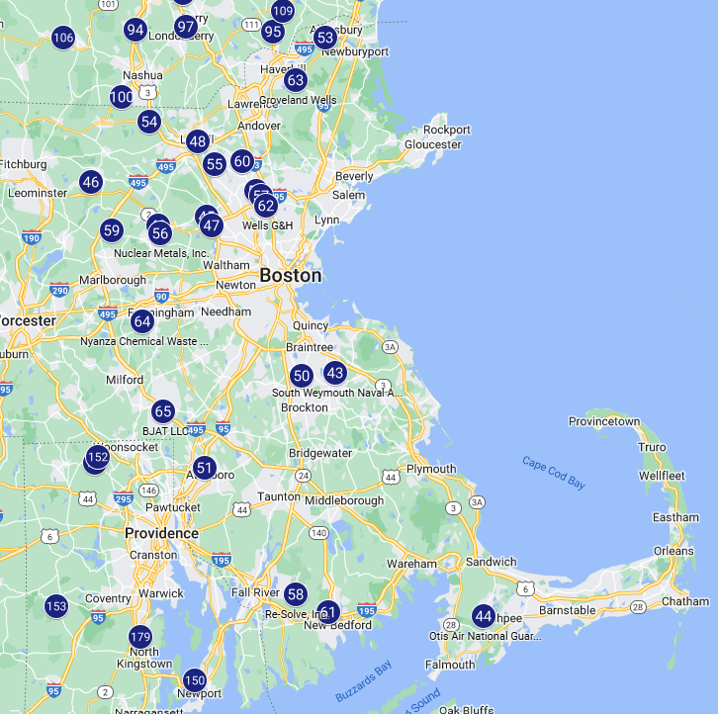
CERCLA Hazardous Substances – PFOA and PFOS
May 2024 Published 40 CFR Part 302
Releases >1 pound/24hr
  Must be reported to National Response Center
Federal entities transferring property must disclose any storage, release, or disposal of PFAS
Will trigger cleanups at Superfund and other sites
  23 Superfund sites in MA with identified PFAS
  All East of Worcester
16

Slide 17
Mass State Regulations and Data

Slide 18
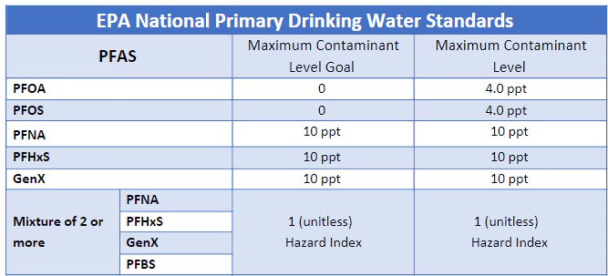
PFAS Regulations in Massachusetts: Drinking Water
MassDEP Drinking Water Program requires public water suppliers to meet drinking water standards (MCLs)
  Massachusetts: 20 ppt for sum of 6 PFAS (PFHpA, PFOA, PFNA, PFDA, PFHxS, PFOS)
  EPA: MCLs for individual PFAS and mixtures not yet enforceable

Slide 19
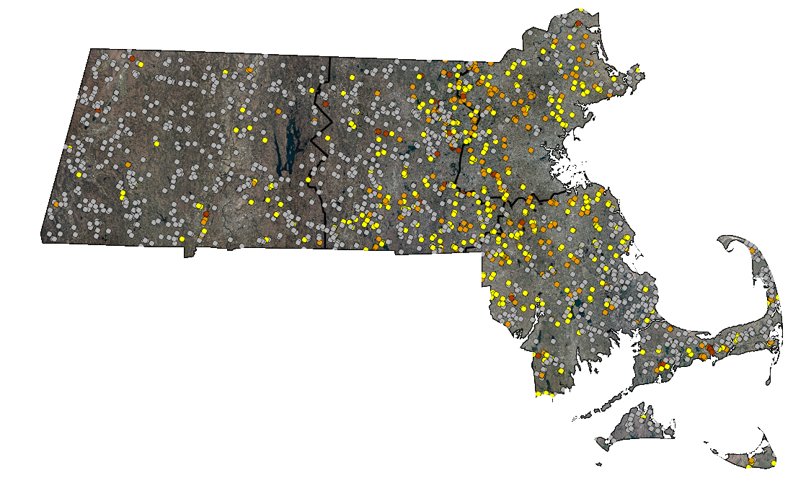
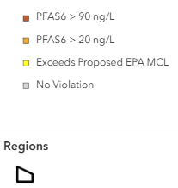
PFAS in Public Water Supplies
PFAS6 > 90 ng/L
PFAS6 > 20 ng/L
Exceeds EPA MCL
No Regulatory Exceedance

Slide 20
Other PFAS Regulations in Massachusetts
MassDEP Wastewater Program is phasing in PFAS testing as part of new permits for surface water discharges
MassDEP Solid Waste Program has started requiring landfills to test for PFAS
  Results may require reporting as a “release”
  If a PFAS “release” occurred at a landfill, cleanup is conducted under the Waste Site Cleanup regulations
PFAS are included in the MassDEP Waste Site Cleanup Program
  PFAS are regulated as a hazardous material
  Groundwater standards
  Soil Standards
  “Reportable Quantity” for a known release of PFAS-containing material

Slide 21
MassDEP PFAS Soil and Groundwater Standards
Standards consider health risk (direct contact, leaching to groundwater, etc.), analytical capabilities, and background levels
Standards are most stringent in current/potential drinking water areas
 | Current/Potential Drinking Water Areas
 | Groundwater | Soil
PFHpA | - | 0.5 ppb
PFOA | - | 0.72 ppb
PFNA | - | 0.32 ppb
PFDA | - | 0.3 ppb
PFHxS | - | 0.3 ppb
PFOS | - | 2 ppb
PFAS6 | 20 ppt | -
Non-Drinking Water Areas
Groundwater | Soil
40,000,000 ppt | 400 ppb
40,000,000 ppt | 400 ppb
40,000,000 ppt | 400 ppb
40,000,000 ppt | 400 ppb
500,000 ppt | 400 ppb
500,000 ppt | 400 ppb
- | -

Slide 22
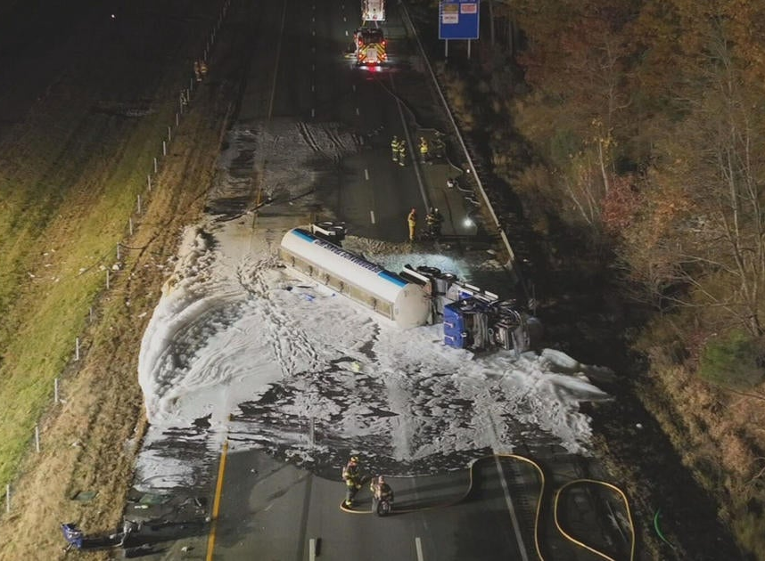
Example of PFAS Release
800 gallons of aqueous film-forming foam (AFFF) applied to suppress gasoline vapors following vehicle accident with tanker truck
AFFF entered wetlands adjacent to the highway and impacts were observed in public water supply wells >1 mile downstream
AFFF Release

Slide 23
MassDEP’s Involvement in Private Wells
Private wells are regulated by local boards of health.
MassDEP does not regulate private wells, but we do regulate contaminants that migrate into in private wells.
MassDEP and UMass partnered to sample ~1,600 private wells in 2020 - 2022
If levels of a contaminant are very high and represent an “Imminent Hazard” condition, MassDEP has a legal requirement to ensure this condition is eliminated.
  Current Imminent Hazard threshold = 90 ppt PFAS6
MassDEP cannot act if we are unaware of contamination!
  Notification requirements for property owners

Slide 24
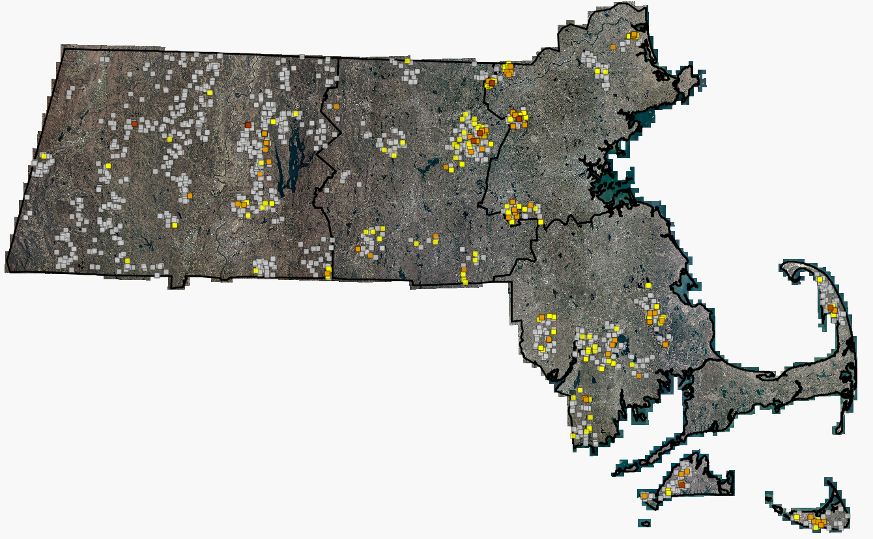
PFAS in Private Wells: UMass/MassDEP Study
PFAS6 > 90 ng/L
PFAS6 > 20 ng/L
Exceeds EPA MCL
No Regulatory Exceedance

Slide 25
Why Should I Care About PFAS?

Slide 26

Public Health
PFAS present real and serious health hazards to the public
Drinking water and wastewater industries are acting as the last line of defense against exposure to the public
Protecting our watersheds should be the top priority
26
Notes:
PFAS can be unintentionally introduced into your product during manufacturing from many different source – such as used of recycled plastics or contaminated local water used in manufacturing.
While these other sources are likely to introduce low concentrations, these low concentrations may still be detectable and of concern to consumers.
Photo from Adobe Stock

Slide 27


Sources of Contamination
PFAS can be introduced by use of contaminated soil, sand, asphalt millings or other aggregates
Clean up of Aqueous Film Forming Foam (AFFF) after vehicle fires
No natural filtration mechanism. Every contamination is a cumulative and permanent addition.
27
Notes:
PFAS can be unintentionally introduced into your product during manufacturing from many different source – such as used of recycled plastics or contaminated local water used in manufacturing.
While these other sources are likely to introduce low concentrations, these low concentrations may still be detectable and of concern to consumers.
Photo from Adobe Stock

Slide 28

Mitigation and Remediation
Granular Activated Carbon (GAC)
  Added to base course during paving. Likely will only be used in target areas
Removal and disposal of contaminated soils and aggregates
Groundwater treatment plant
28
Notes:
PFAS can be unintentionally introduced into your product during manufacturing from many different source – such as used of recycled plastics or contaminated local water used in manufacturing.
While these other sources are likely to introduce low concentrations, these low concentrations may still be detectable and of concern to consumers.
Photo from Adobe Stock

Slide 29

Public Perception
Public awareness of PFAS is growing through wide coverage in the news
The general public wants to know if they are being exposed to PFAS
Get ahead of the information curve. Have answers to their questions before they start asking
29
Notes:
PFAS can be unintentionally introduced into your product during manufacturing from many different source – such as used of recycled plastics or contaminated local water used in manufacturing.
While these other sources are likely to introduce low concentrations, these low concentrations may still be detectable and of concern to consumers.
Photo from Adobe Stock

Slide 30
PFAS in Public Water Systems

Slide 31
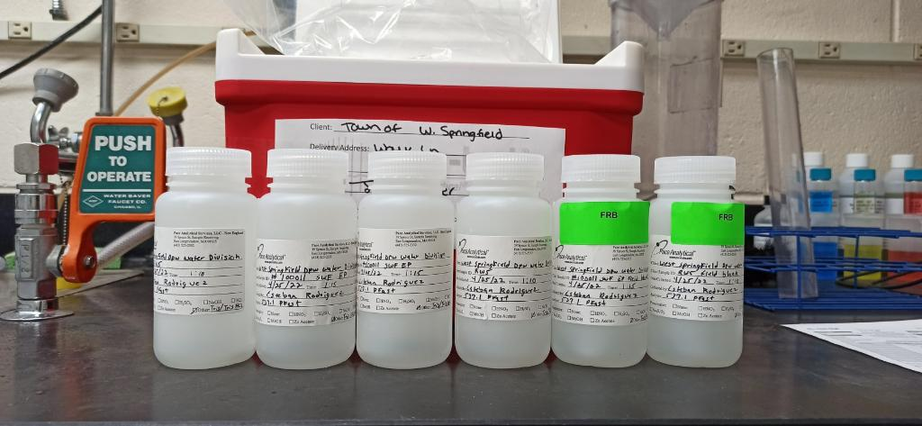
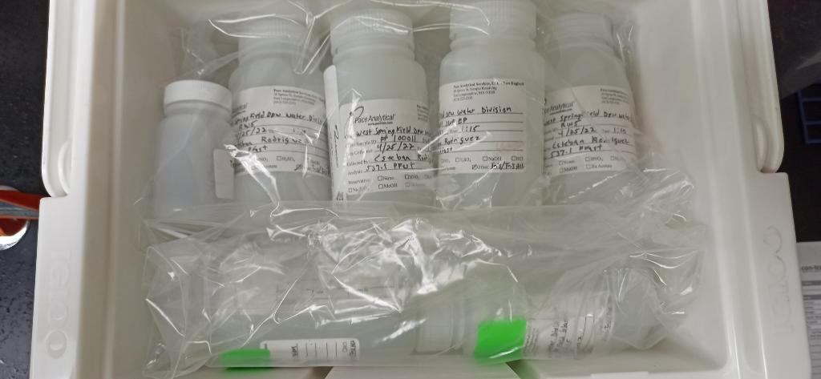
Testing
EPA UCMR3 2013-2015
EPA UCMR5 2023-2025
Sample collection is challenging
Few certified laboratories
Results reports are more complicated
31
Notes:
PFAS can be unintentionally introduced into your product during manufacturing from many different source – such as used of recycled plastics or contaminated local water used in manufacturing.
While these other sources are likely to introduce low concentrations, these low concentrations may still be detectable and of concern to consumers.
Photo from Adobe Stock

Slide 32
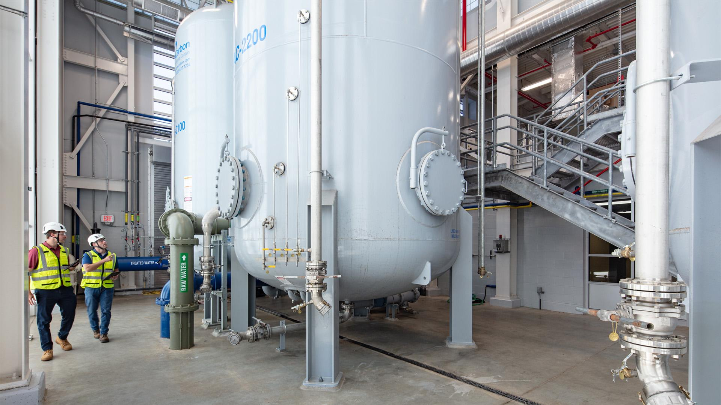

Treatment: Granular Activated Carbon
Easy to operate
High construction cost
Operational cost varies dependent on contaminant levels
32
Notes:
PFAS can be unintentionally introduced into your product during manufacturing from many different source – such as used of recycled plastics or contaminated local water used in manufacturing.
While these other sources are likely to introduce low concentrations, these low concentrations may still be detectable and of concern to consumers.
Photo from Adobe Stock

Slide 33
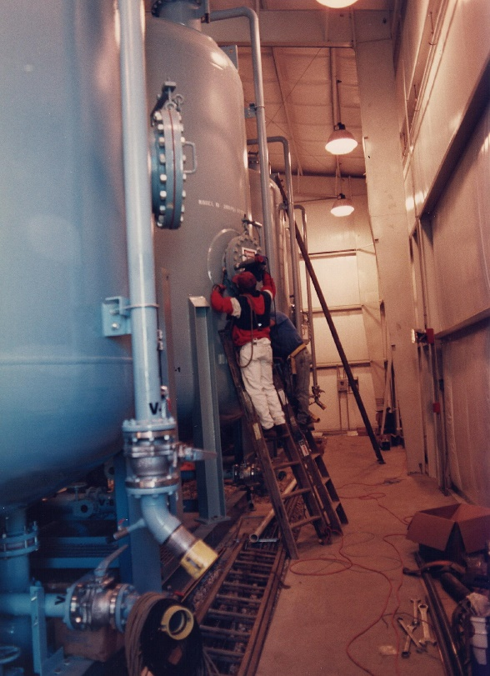
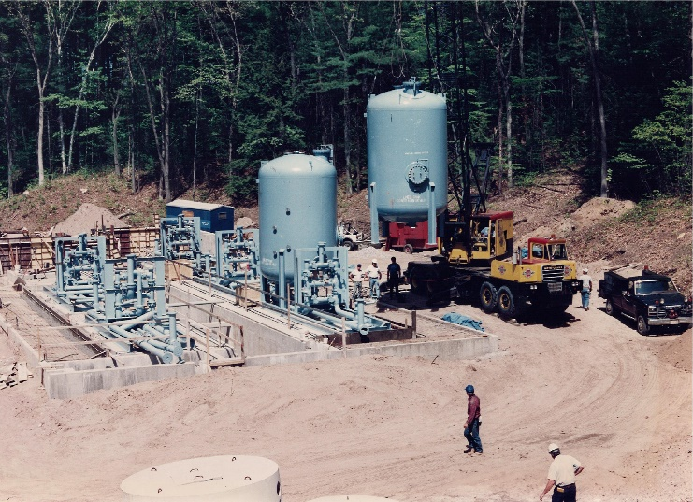
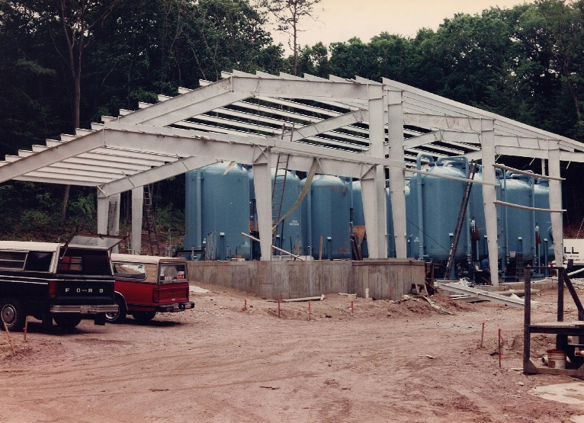
Treatment: Granular Activated Carbon
33
Notes:
PFAS can be unintentionally introduced into your product during manufacturing from many different source – such as used of recycled plastics or contaminated local water used in manufacturing.
While these other sources are likely to introduce low concentrations, these low concentrations may still be detectable and of concern to consumers.
Photo from Adobe Stock

Slide 34
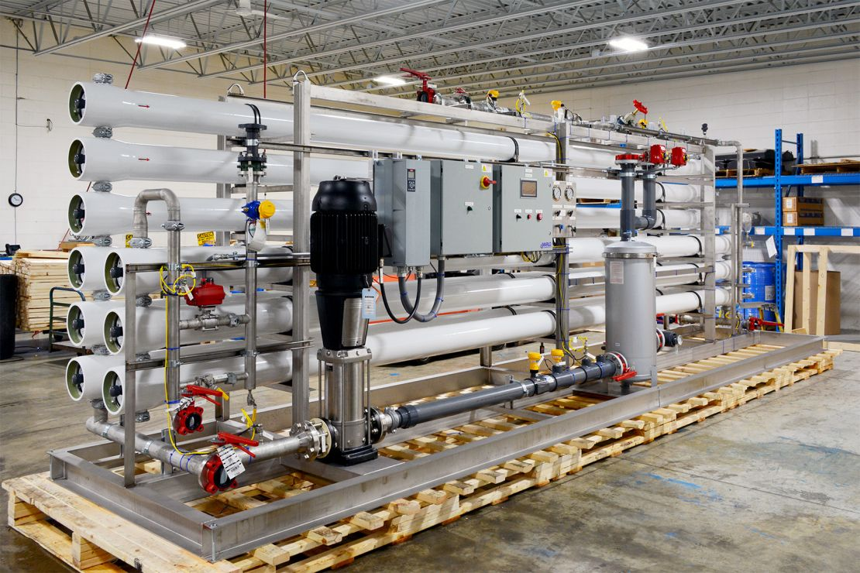
Treatment: Reverse Osmosis
High pressure pumps force water through filter membranes
High cost for construction and operations
Removal of inorganic minerals
pH imbalance
34
Notes:
PFAS can be unintentionally introduced into your product during manufacturing from many different source – such as used of recycled plastics or contaminated local water used in manufacturing.
While these other sources are likely to introduce low concentrations, these low concentrations may still be detectable and of concern to consumers.
Photo from Adobe Stock

Slide 35
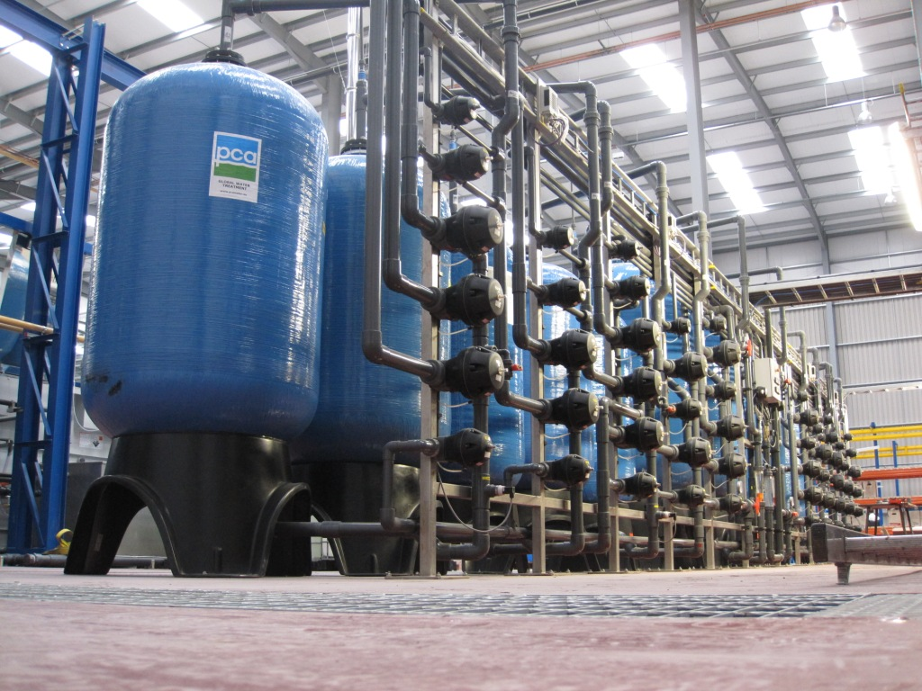
Treatment: Anion Exchange Resin IEX
Positively charged beads that remove negatively charged ions
High construction cost, low operational cost
Requires frequent recharge of the resin, which generates wastewater during backwash
35
Notes:
PFAS can be unintentionally introduced into your product during manufacturing from many different source – such as used of recycled plastics or contaminated local water used in manufacturing.
While these other sources are likely to introduce low concentrations, these low concentrations may still be detectable and of concern to consumers.
Photo from Adobe Stock

Slide 36
Yarmouth’s Story

Slide 37
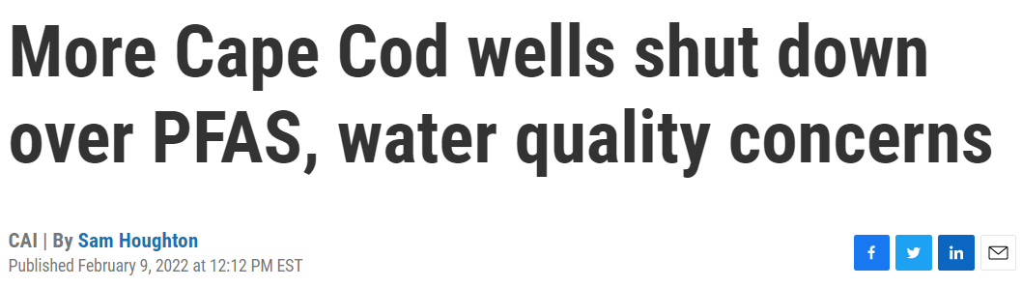
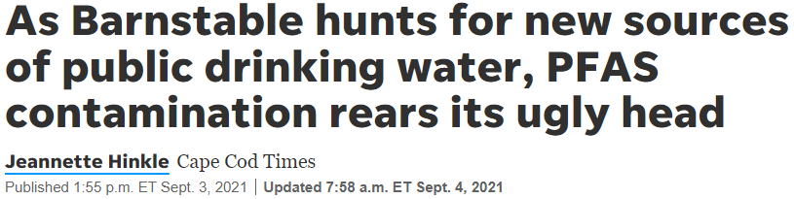
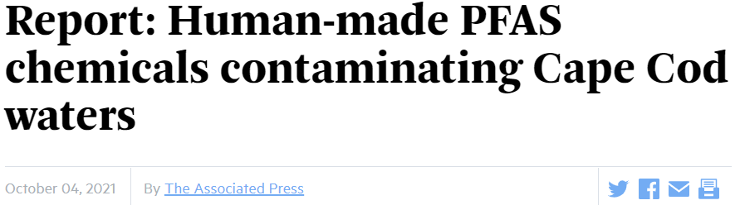
Yarmouth’s Story
Yarmouth’s first round of sampling of all 24 wells showed no wells over the Massachusetts MCLs.
Continued sampling showed three wells slightly over the MMCL. Immediately shutdown the impacted wells.
Notes:
Yarmouth has 24 drinking water wells with minimal treatment (chemical addition only).
Loss of approximately 1.3 MGD of capacity.

Slide 38
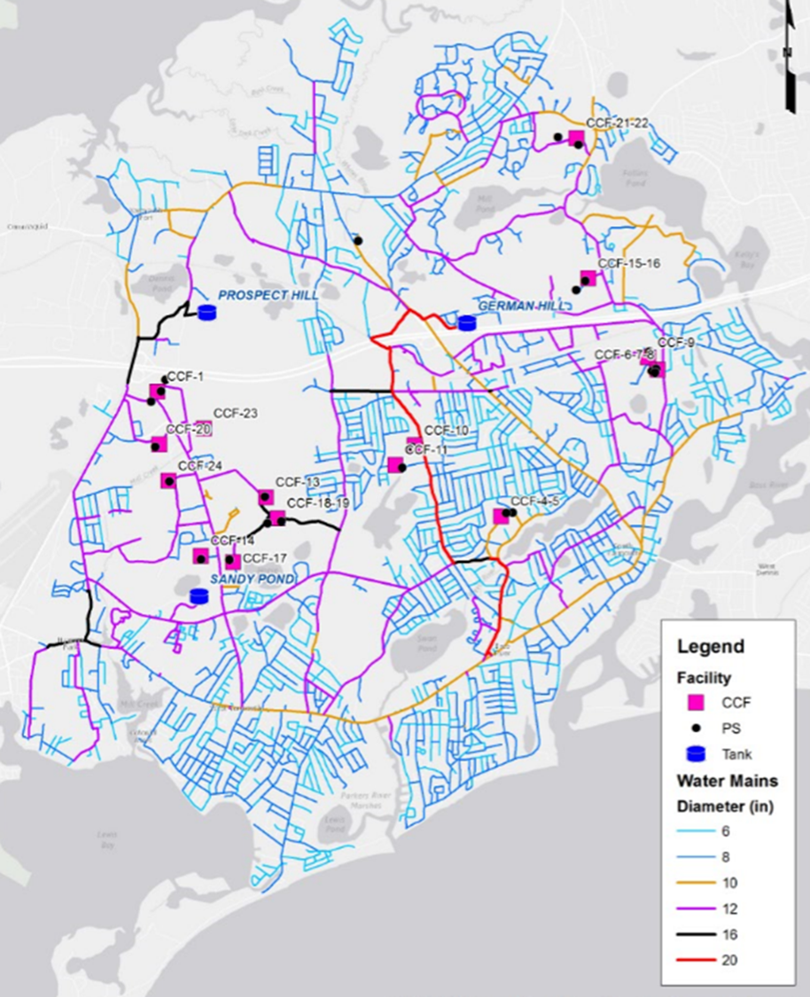
Source of PFAS in Yarmouth
Large sources like the Fire Training Academy and the Airport are not upstream of these wells.
Landfill is possible, sampling around the landfill is underway.
Most likely source: Septic Systems
Landfill
Impacted Wells
Fire Training Academy & Airport
Notes:
No smoking gun source to blame in Yarmouth. Most likely culprit – septics.

Slide 39
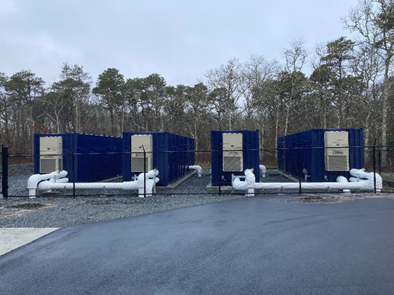
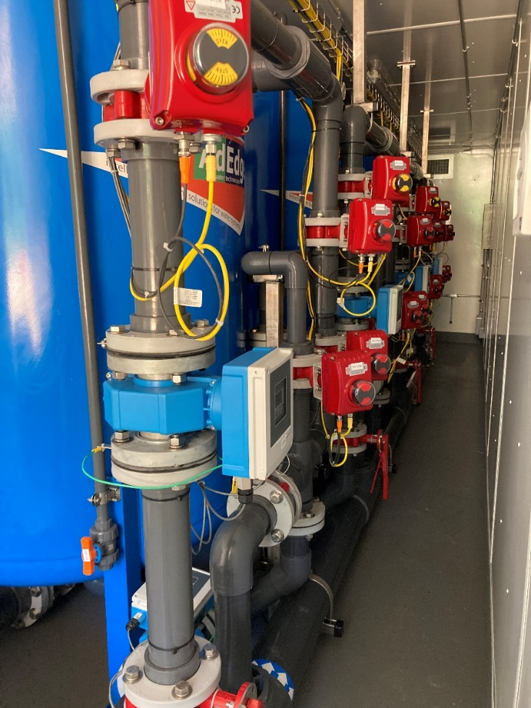
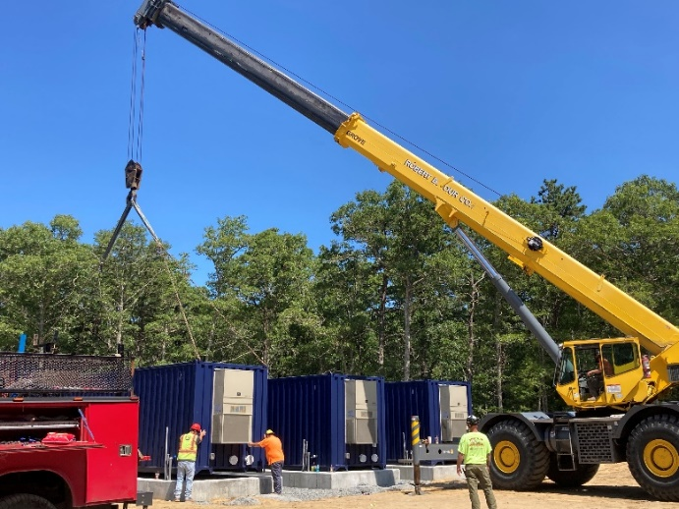
Yarmouth’s Solutions: Treatment
Notes:
Wells 4 & 5 are on the same site, so treated them first to get the most capacity back.
Media is FluoroSorb – proprietary media from AdEdge. It’s an adsorptive media.
Installation took longer than expected but project to just over a year from start of design through completion.
Currently conducting piloting for treatment at Wells 10 and 11.

Slide 40
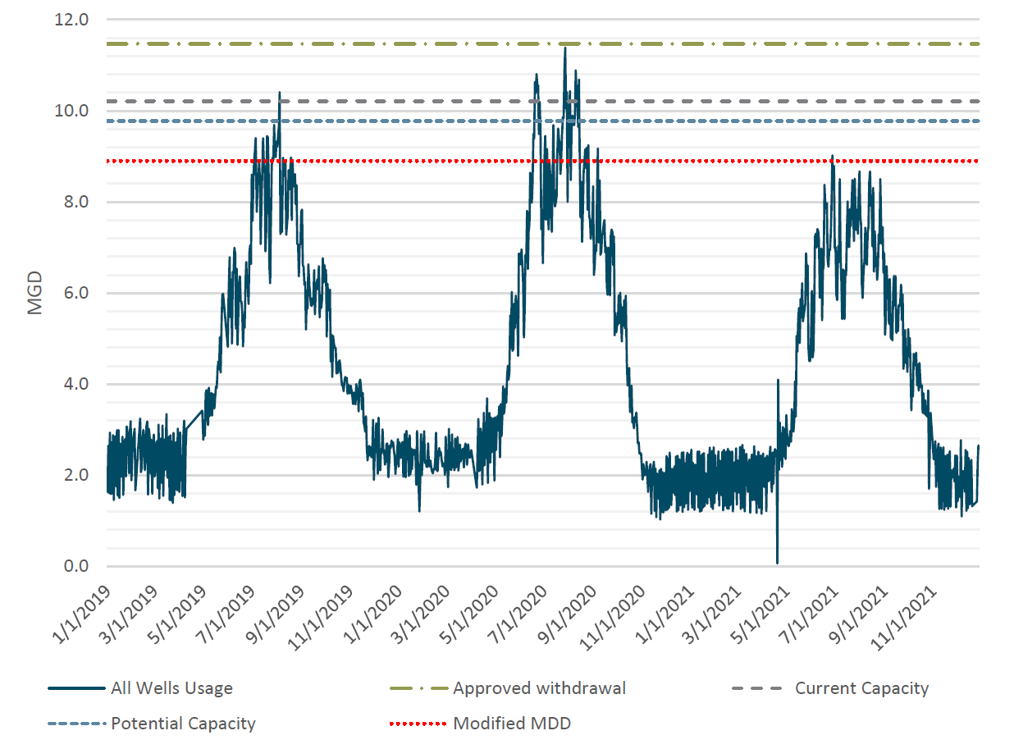

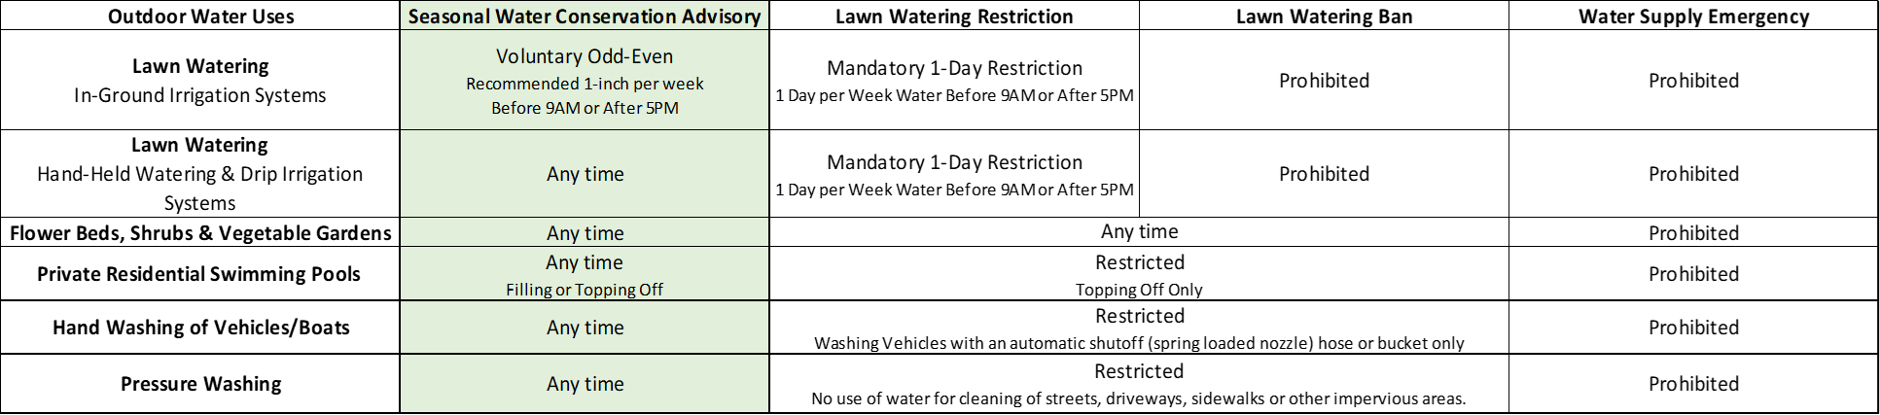
Yarmouth’s Solutions: Water Conservation
Notes:
Yarmouth can meet demands most of the year without the PFAS wells, but we could not meet peak summer demands. Therefore, conservation measures were impletmented for the first time ever in Yarmouth.

Slide 41
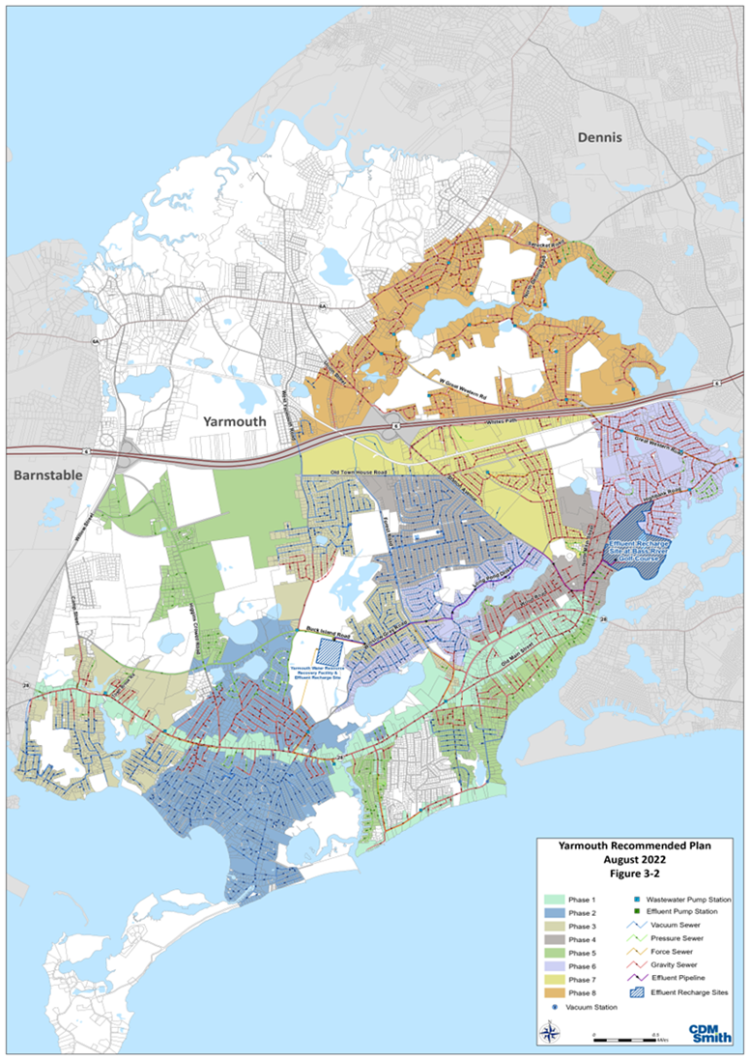
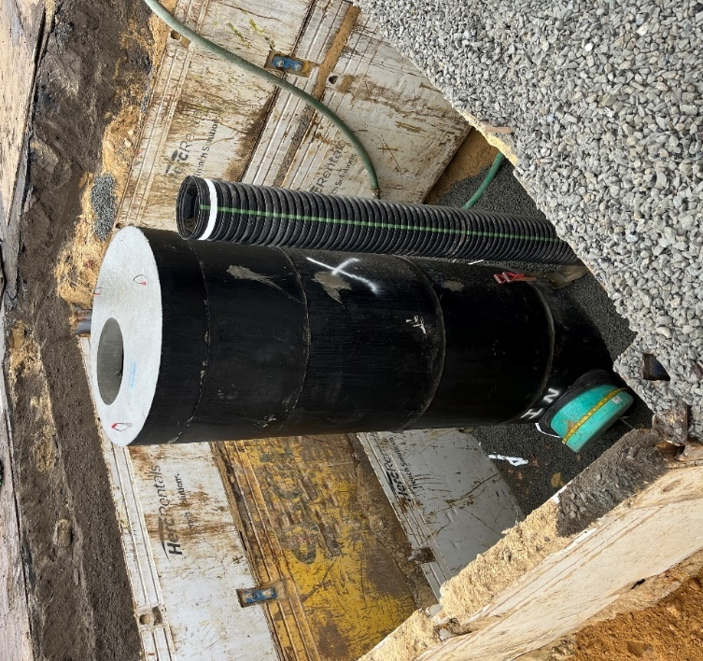
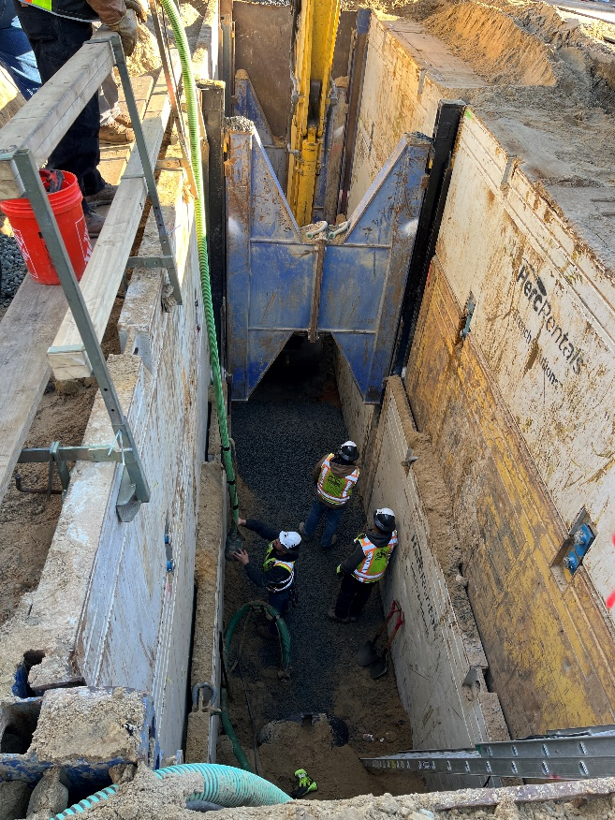
Yarmouth’s Solutions: Sewer
Notes:
Yarmouth’s sewer plan was not meant to address PFAS but will remove septic systems that are contributing to PFAS at our wells.

Slide 42
Contact Information
Linda Cook
Senior Technical Leader
Weston & Sampson
cook.linda@wseinc.com
Laurie J. Ruszala, P.E.
Water & Wastewater Superintendent
Town of Yarmouth
lruszala@yarmouth.ma.us
Natalie Johnson, PhD
Mass DEP
Bureau of Waste Site Cleanup
Northeast Regional Office
natalie.johnson@mass.gov
Michael O’Connell
Deputy Director of Water
Town of West Springfield
moconnell@tows.org

